Slide 1
Coupon Management App
Presenter: Dinesh Thanigaivel
Reviewers: Sven Haase & Robert Blesch

Slide 2
Agenda:
Introduction
Architecture Diagram
API Functionality Overview
Identified Bugs by Class / Module
Improvements and Suggestions

Slide 3
Introduction:
Purpose of the Application: A coupon management system designed to create coupons and facilitate discounts and also maintains the coupon details
Key Technologies Used: Developed using Java and Spring Boot, Swagger, with JPA for database interaction and H2 for in-memory storage during testing.
API-Driven Architecture: Utilizes RESTful APIs to provide a scalable and modular approach for handling coupon operations.
Scope of Review: Focuses on identifying code quality issues, potential bugs, and proposing improvements to enhance maintainability and performance.

Slide 4
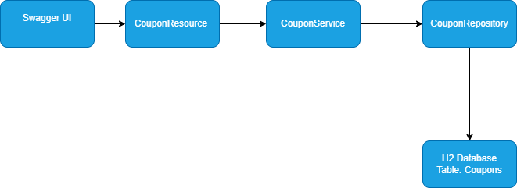
Architecture Diagram:

Slide 5
API Functionality Overview:
Create coupon → POST /api/create
  Creates a new coupon with code, discount, and minimum basket value.
Get coupon → GET /api/coupons
  Retrieves coupons based on provided codes
Apply Discount → POST /api/apply
  Applies a coupon to a basket and calculates the discount

Slide 6
Identified Bugs by Class / Module:
Class / File Name | Bugs Identified
application.yml | 1
data.sql | 1
build. gradle | 1
CouponRepository.java | 1
CouponService.java | 7
Basket.java | 3
Coupon.java | 3
CouponDTO.java | 1
ApplicationRequestDTO.java | 1
CouponRequestDTO.java | 1
CouponResource.java | 1
CouponServiceTest.java | 3
Note: Bug details are available in “Bugs_report.docx”

Slide 7
Improvements and suggestions:
Use @RestController Instead of @Controller
  Simplifies code by combining @Controller + @ResponseBody.
Proper HTTP Status Codes
  Use 201 Created, 404 Not Found, 409 Conflict, 400 Bad Request for accurate API responses.
Use Slf4j for logging
  Replace System.out.println with log.info/debug/error for maintainable logs.
DTO Validation Enhancement
  Add @NotNull, @NotBlank, @Positive annotations to prevent invalid input.
Safe Optional Handling
  Avoid .get() on Optional; use ifPresent(), orElseThrow() to prevent runtime exceptions.
Increase Test Coverage
  Add negative and boundary test cases to ensure all scenarios are validated.

Slide 8
Thanks, Have a nice day

